Slide 1


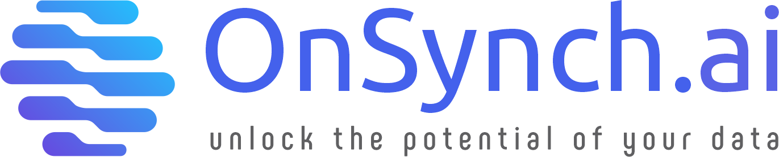

CUSTOMER 360 - CASE STUDY
www.onsynch.ai

Slide 2
Executive Summary
Case study highlights a Customer 360 solution built on the Databricks Lakehouse Platform to unify customer data and drive insights.
Solution Architecture - A scalable architecture using Databricks for data ingestion, processing, and analytics.
Delta Lakehouse Modelling - Data structured in Bronze, Silver, and Gold layers using Delta Lake for reliability and performance.
Lakehouse Setup
Workspace: Created a secure and collaborative Databricks workspace.
Storage: Set up cloud object storage for raw and processed data.
Unity Catalog: Enabled centralized governance and access control.
Catalogs & Locations: Defined data environments and external access paths.
Source Control: Integrated Git for version control and automation.
Data Ingestion & Processing
Historic Loads: Ingested legacy data into Bronze and Silver layers.
Incremental Loads: Built pipelines for real-time data updates.
ML Models: Used MLflow to develop and track customer models.
Gold Layer: Created optimized Delta tables and materialized views.
Cost Monitoring - Monitoring usage and spend using Databricks cost tools and dashboards.
Data Governance - Applying RBAC and Unity Catalog for secure, compliant data access.
Data Serving - Serving curated data to BI tools and downstream systems for insights.

Slide 3


Agenda
Solution Architect
Delta Lakehouse Modelling
Lakehouse Setup
Create Workspace
Create Storage Layer
Create Unity Catalog & Metastore
Create Catalogs & external locations
Setup Source Control
Data Ingestion & Processing
Load Bronze & Silver – Historic Data
Load Bronze & Silver – Incremental Data
Machine Learning Model – Using ML Flow
Create Gold Tables (Materialized views and Optimized delta table)
Cost Monitoring
Data Governance
Data Serving

Slide 4




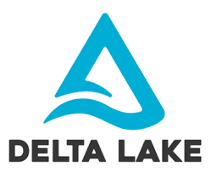


Customer 360 – Solution Design
End-to-end Lakehouse solution leveraging Databricks for scalable ingestion, unified governance, Delta pipelines, and MLflow for predictive insights
Workspace Management & Cluster Policies
Loan Application
Databricks Cluster
Azure SQL
Spark App
Spark App
Spark App
Spark App
Customer Profile
UNITY CATALOG
Kafka
BRONZE
SILVER
GOLD
Transactions
ADLS GEN2 STORAGE ACCOUNT
/data_zone
bronze_db
silver_db
gold_db
Credit Scores
/checkpt

Slide 5
Customer 360 – Delta Lakehouse Modelling
Structured Customer 360 data across Bronze, Silver, and Gold layers using Delta Live Tables, with support for time-travel, quality checks, and ML-ready features.
Data Zone - Directory
Bronze Layer
Silver Layer
Gold Layer
Loan Application
/loan_app
bronze_loan_applications
silver_loan_applications
Azure SQL
/customers
bronze_customer_profiles
silver_customer_profiles
gold_customer_clv_segment
Customer Profile
gold_customer_risk_predictions
/transactions
bronze_transactions
silver_transactions
Transactions
silver_ml_dataset
gold_customer_risk_training_dataset
/credit_score
br_credit_score
silver_credit_score
Credit Scores
Source Layer

Slide 6
Customer 360 – Lakehouse Setup
Unified governance and scalable storage with Delta Lake, Unity Catalog, and Databricks Workflows across Bronze, Silver, and Gold layers.
1. Create Workspace
2. Create Storage Layer
3. Setup Unity Catalog & Metastore
4. Create Catalog and Locations
5. Setup Source Control
Go to Azure / GCP and create your Databricks workspace
Make sure your Databricks workspace is in the same region as your resource group
Create Storage Account
Create Storage Container
Setup Storage Access Connector for Databricks
Pre-Requisite
Databricks premium workspace
Path to storage container
Resource ID of Databricks connector
Create catalog for managed tables and defines its location
Create location for unmanaged location
Create location for checkpoints
Create Repo in your company's Azure Devops
Create Project Folder in Repo
Link it to the DevOps Repo
Enable Unity Catalog, configure audit logging, and enforce cluster policies to strengthen governance and optimize costs

Slide 7
Customer 360 – Data Ingestion & Processing
Unified ingestion of streaming and batch data sources using Kafka, Autoloader, Fivetran, DBT, and APIs into Delta Lake with scalable transformation via DLT pipelines.
1. Load historic data
2. Ingest Bronze Layer
3. Process Silver Layer
4. ML Model
5. Gold Layer
Load loan application data
Load customer profile
Load transaction data
Load credit score
Load incremental loan application data
Load incremental customer profile
Load incremental credit score
Load incremental transaction data
Create ml_dataset
Create ml_model_train dataset
Setup ML Flow
Create train & test dataset
Run different ML models
Log metrics in ML Flow
Predict
Create credit risk score generated by ML model (ZORDER)
Create Customer Lifetime Value by Segment table for reporting
Historic – Bronze & Silver
Incremental - Bronze & Silver Load Scripts
ML Models Dataset Creation, Modelling & Materialized Views

Slide 8
Customer 360 – Cost Monitoring, Alerting
Track cluster and SQL compute costs via LakeView dashboards with cost attribution by workspace, user, and job, and configure budget alerts via Azure Cost Management or Databricks billable usage tables.
Alert Creation
Monitoring – Usage Dashboard
Daily DBU spike alert
SELECT
DATE(CURRENT_TIMESTAMP) AS check_date,
ROUND(SUM(dbu_usage), 2) AS dbu_today
FROM system.billing.usage
WHERE usage_start_time >= CURRENT_DATE()
HAVING dbu_today > 100 – Threshold
User exceeds 50 DBUs per day
SELECT
user_name,
ROUND(SUM(dbu_usage), 2) AS total_dbu
FROM system.billing.usage
WHERE usage_start_time >= CURRENT_DATE()
GROUP BY user_name
HAVING total_dbu > 50;
DBU over time
Track DBU consumption across year, quarter, month, week, and day to identify peak usage patterns and optimize resource allocation
DBU Cost by Clusters
Break down DBU costs by cluster to pinpoint high-consumption workloads and optimize spend.
DBU Cost by Users
Analyze DBU spend by user to drive accountability and optimize compute usage.
Storage Cost by Tables
Track storage consumption at the table level to manage data growth and reduce cost
SQL query to track and analyze compute and storage costs across users, clusters, and tables.

Slide 9


Customer 360 – Data Governance
Centralized metastore across all workspaces, secure access to all data assets: tables, views, volumes, models
Metastore
Unified Data Governance
Metastore , Secure access
Access Control
Object, Row / Column Level Security
Auditing & Lineage
System tables, lineage tracing
Leading Practices
SQL Query
Area | Practice
Data Access | Use group-based roles (SCIM sync)
Separation | Separate catalogs per environment (Dev/Prod)
Classification | Tag data sensitivity levels
Least Privilege | Grant minimum necessary permissions
Monitoring | Use system tables + LakeView dashboards
Retention | Use Delta Time Travel + VACUUM policies
Data governance is the practice of managing the availability, usability, integrity, and security of data to ensure compliance and quality across an organization.

Slide 10

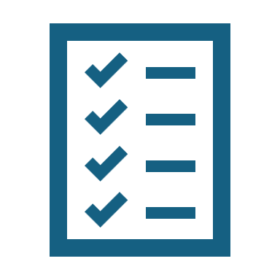

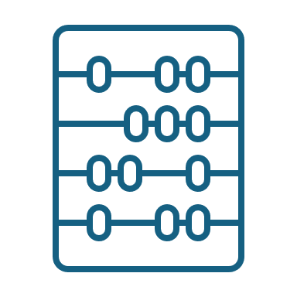
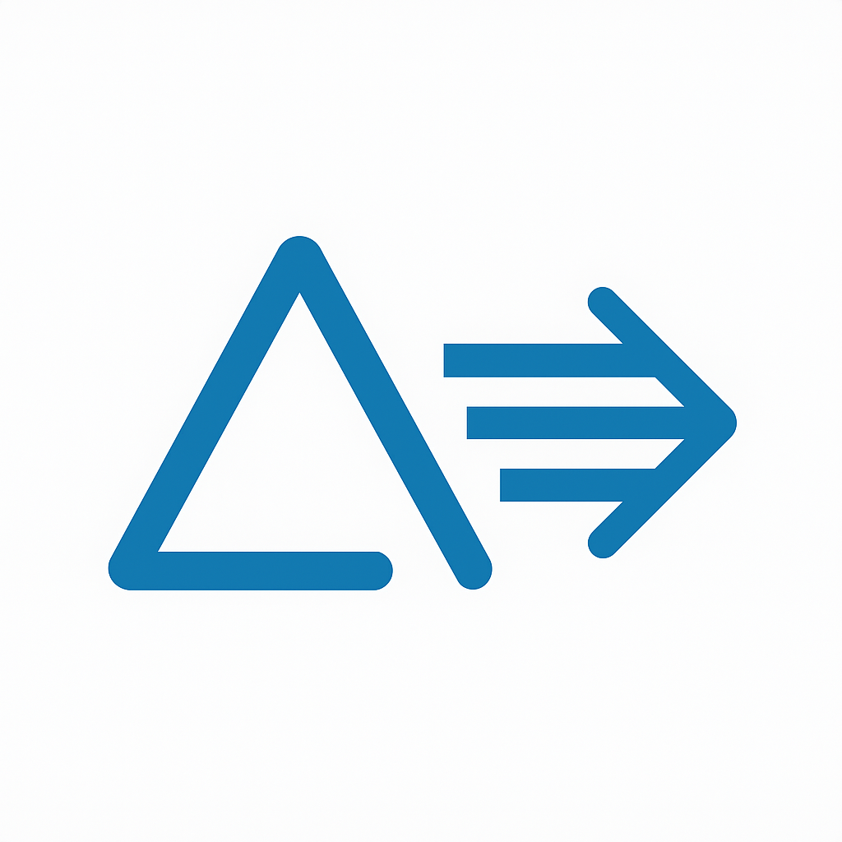




Customer 360 – Data Serving
Curated Gold tables, MVs, and Delta Sharing deliver secure, real-time insights to BI tools, ML models, and partners—powered by Unity Catalog governance and optimized for performance
DATA SERVING
Data serving involves efficiently delivering processed and aggregated data for reporting and analytics.
Gold Tables
Clean, trusted, business-ready data
Materialized
Views
Pre-aggregated KPIs (CLTV, risk segments)
Feature Store
Model features for real-time/ batch ML
TVFs
Reusable logic for filtering (e.g., active_customers_last_30d())
Delta Share
Open and secure data access for partners
SERVING LAYER
CONSUMERS
BI reporting users
AI / ML Teams
Marketplace

Slide 11

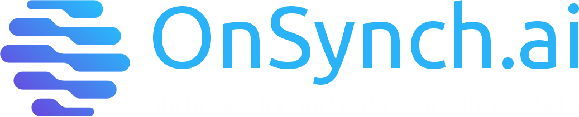
THANK YOU
www.onsynch.ai

